Slide 1
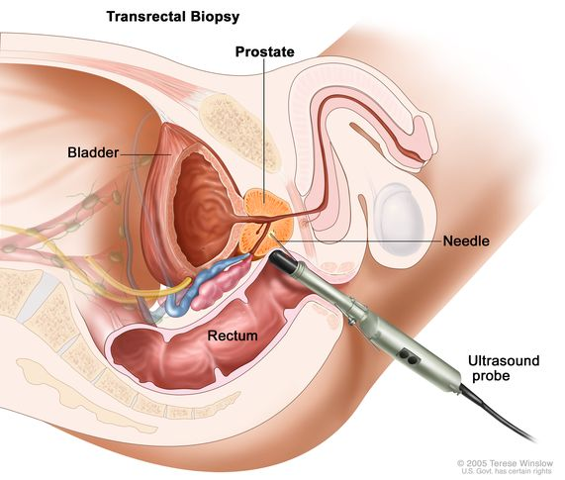
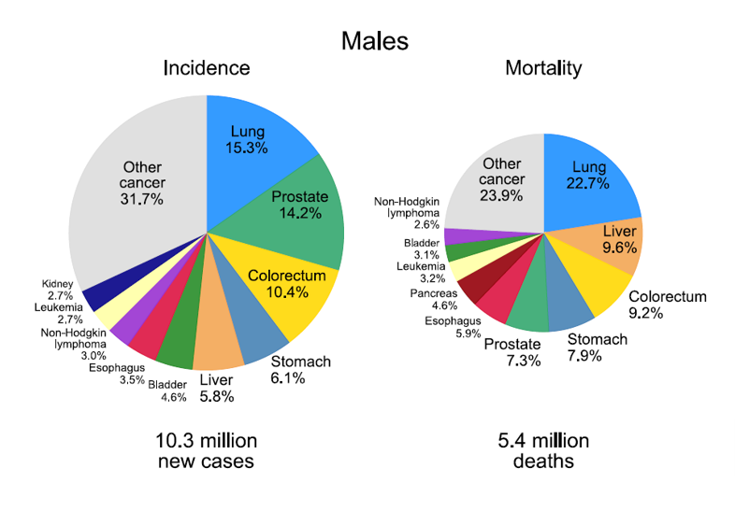
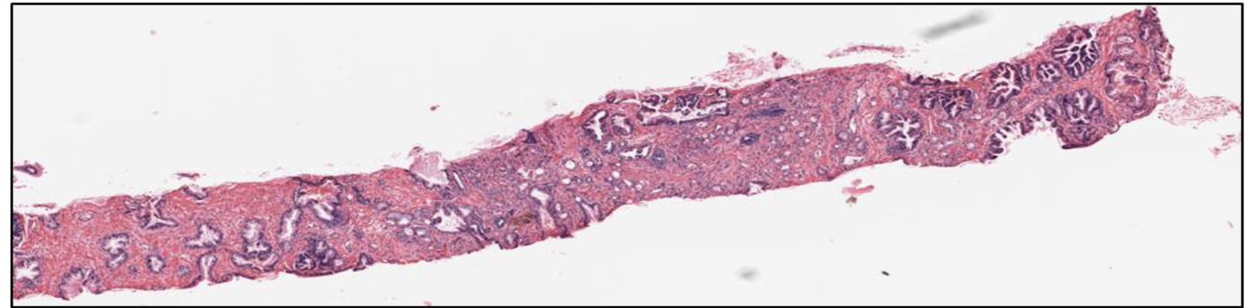
Prostate Cancer & Gleason Grading
Prostate Cancer is the second most diagnosed non-skin cancer in men worldwide (1st in the US)
Diagnosis is made using biopsy samples examined under the microscope by a pathologist

Slide 2
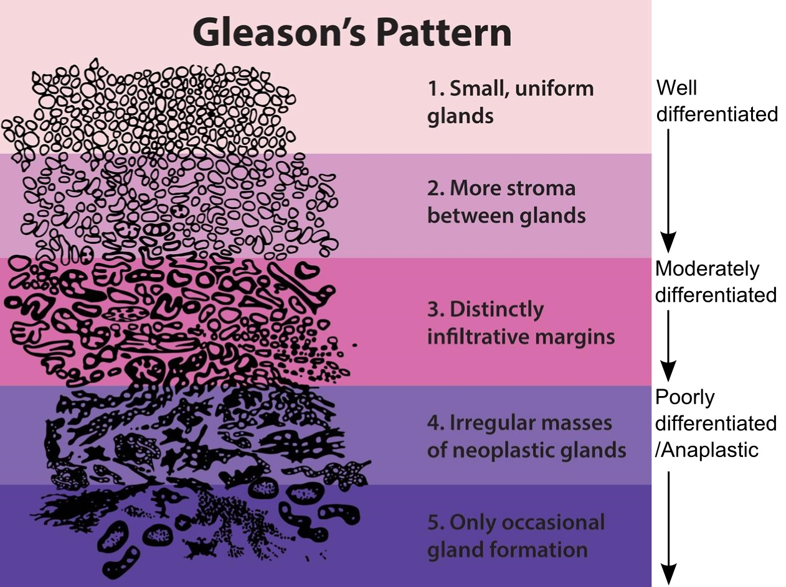
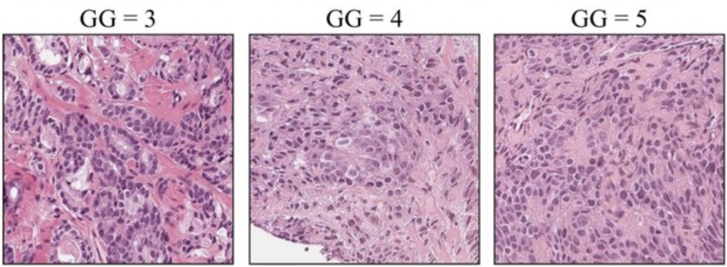
Prostate Cancer & Gleason Grading
The Gleason grading system is used to assess how aggressive the cancer is, based on glandular architecture seen in H&E-stained biopsy tissue. This grade influence treatment decisions: surveillance vs surgery/radiation.

Slide 3
Why Automate Tissue Segmentation?
Manual Gleason grading is time-consuming and subject to interobserver variability, especially between intermediate grades.
Automated segmentation into benign epithelium, stroma, and Gleason patterns will: a) standardize diagnosis, and b) enable large-scale analysis across thousands of cases

